Slide 1
The emergence and stabilization of scientific pluralities: a model-based approach
Matteo De Benedetto, Michele Luchetti & Matteo Michelini
matteo.debenedetto@imtlucca.it michele.luchetti@uni-bielefeld.de
matteo.michelini@ilc.cnr.it
IMT School for Advanced Studies Lucca
Universitat Bielefeld
Consiglio Nazionale delle Ricerche (CNR)
SILFS Triennal Conference Pavia
29/06/2026

Slide 2
Scientific Pluralism
In the last decades, many philosophers of science have argued for the epistemic benefits of maintaining a plurality of theories/approaches within a single domain (Chang 2012; Longino 2019)
Support typically comes from historical or practice-focused case studies or from a priori arguments:
  reconstructing episodes from the history of science where plurality emerged, stabilized, or collapsed and evaluating thechoices underlying these developments (e.g., Chang 2012, Nickelsen 2021)
  Principled arguments on why pluralism needs to be promoted to safeguard other things we value in science and/or in society (e.g., Longino 2002, Chang 2022)

Slide 3
Terminology: Pluralism(s) and pluralities
The philosophical literature distinguishes many forms that scientific pluralism can take (cf. Ruphy 2016, Ludwig and Ruphy 2021), depending on the nature (epistemic, metaphysical, etc.), the target (models, theories, methods), or the scope of the pluralism (e.g., local, disciplinary, global).

Slide 4
Terminology: Pluralism(s) and pluralities
The philosophical literature distinguishes many forms that scientific pluralism can take (cf. Ruphy 2016, Ludwig and Ruphy 2021), depending on the nature (epistemic, metaphysical, etc.), the target (models, theories, methods), or the scope of the pluralism (e.g., local, disciplinary, global).
Following (Kellert et al. 2006), it is standard practice to distinguish
  Plurality: Empirical state of a multiplicity of theory, models, methods, etc. in a given science, practice, etc.
  Pluralism: Positive normative stance towards the existence of scientific plurality (because they are necessary, beneficial, etc.)

Slide 5
What structural features of scientific communities favor the emergence and persistence of scientific plurality?
Not: another normative argument for or against pluralism. Rather:
Rather: which factors in the fabric of science push a community towards, or pull it away from, a state of theoretical and methodological plurality?

Slide 6
Two Structural Factors
In particular, we focus on two structural factors of the evolution of a given scientific community:
Structure of the internal discussion and reward system: global vs local; standardized vs balkanized.
Epistemic Standards: single vs multiple standards; fixed vs dynamic standards.

Slide 7
The Case for Global Discussion
Social epistemology often asks: which structural factors make scientific community optimal?
Common view: communities should structure debate through general, open venues
  Longino (1990), Science as Social Knowledge: critical discourse as the route to objectivity
  Kitcher (2001), Science, Truth, and Democracy: well-ordered science requires general, representative deliberation
Both views converge on: general/open discussion as a structural ideal for having a plurality of view within the community.
The Case for Local Discussion
On the other hand, many philosophical models of science dynamics emphasize the merits of localized scientific groups working in a relative isolation:
  Kuhn (1962, 1977, 1990): importance of linguistic and geographical barriers for scientific specialization and evolution. See also the explication of Kuhn’s speciation metaphor in Wray (2011)
  Hull (1988): significance of local conceptual and methodological demes for scientific progress
These broadly-Kuhnian views can be interpreted as arguing for a positive role for local discussion (and a reward system based on subgroups) in diversifying scientific communities.

Slide 8
Epistemic Standards in Science
The second structural factor is the nature of the epistemic standards governing the evaluation and acceptance of scientific hypotheses within a given scientific community.
Specifically, we study the variation of this factor across two dimensions:
Whether there is a single standard of acceptance or multiple ones within a community
Whether these standards are fixed once and for all or they evolve in response to the evolution of theories.
(NB: the variation on this factor has interesting connections with positions in the debate over the unity and disunity of science and the related debate on theoretical virtues)

Slide 9
The modelling approach
We develop an agent-based model of the co-evolution of scientific theories and scientific methodologies within a given community.
We test whether different social structures of the community positively or negatively affect the rate of emergence and stabilization of a state of plurality (in both theories and methods).
We do that by changing our three structural parameters (standards of evaluation, reward structure) in the evolution of the community and see what happens.
The model lets us isolate and test the effect of these structural parameters on theoretical and methodological pluralities directly (Michelini & Seselja, 2026).

Slide 10
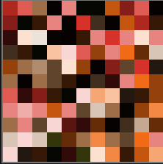







The Model
Each tile is a scientists
Each scientist has some neighboring scientists
A scientist subscribes to a system of values (which correspond to epistemic standards).
The color represents the theory chosen by an agent.
Each theory is mathematically represented by a binary vector e.g. T = (1,0,1,0,0).
Each value system assigns a specific score to each theory.
Notes:
A system of values corresponds to a specific set of epistemic standards. Cite Kuhn. A set of epistemic standards allows to rank the theories. Different scientists with different standards may obtain different rankingsa.

Slide 11




The Model
Scientific Evaluation Phase
Each scientist obtains a certain amount of scientific success.
Scientific success == average theory score wrt to the standards of those who evaluate her (Credit Economy, e.g. Zollman, 2018).
Global evaluation: everybody evaluates everybody else.
Local evaluation: everybody only evaluates people around her.
Scientific Evolution Phase
Agents have a chance of updating their theory and value system.
Selection. Each agent (learner) picks out another agent (target). If the learner has scored worse than the target, she copies the theory and value system of the target.
Mutation. Each agent’s theory and value system can then undergo a mutation. One component of her theory may change.

Slide 12
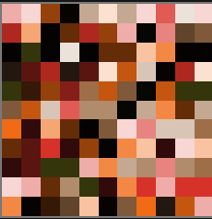
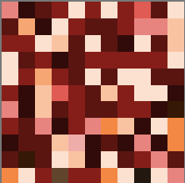

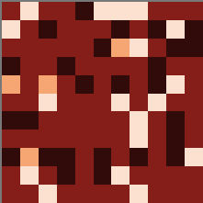

The Model
t = 0
t = 50
t = 200
t = 1000
Does the community reach a stable state of plurality?
Parameters | Values
Evaluation/Imitation | Local, Global
Evaluative Standards | Fixed Homogeneous, Fixed Heterogeneous, Varying

Slide 13
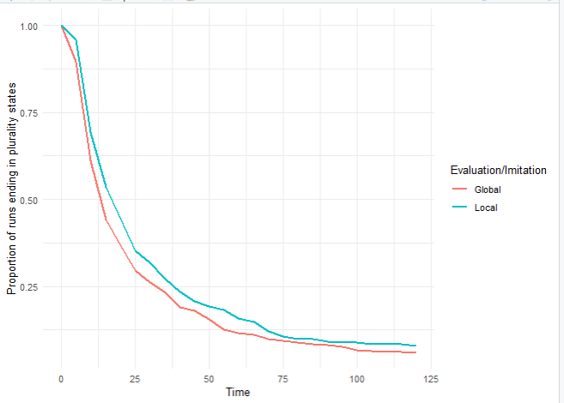
The Results - I
Under which conditions does the community reach a stable state of plurality?
If the standards are homogeneous and fixed...

Slide 14
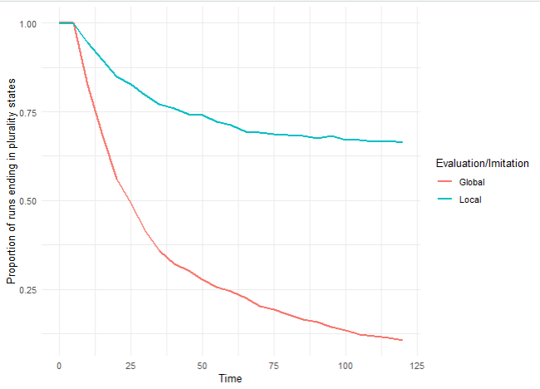


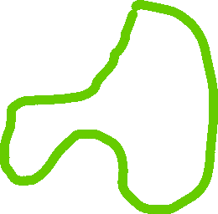




The Results - II
Under which conditions does the community reach a stable state of plurality?
When the standards are multiple and heterogeneous a local discussion process preserves plurality.
If the standards are hetergoeneos (and fixed)...
Evaluative cluster 2
Evaluative cluster 1

Slide 15
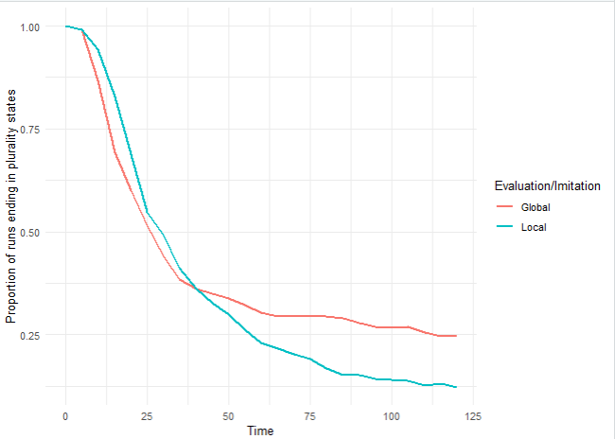




The Results - III
Under which conditions does the community reach a stable state of plurality?
Since standards can evolve, the community likely collapses in homogeneous values.
Once values are homogenous, the community is also likely to collapse on the same theory.
If the standards are heterogenous and evolving...
(remember that standards evolve as result of imitation/mutation).
...when is this not the case?
Notes:
How do values evolve?
Synchronous – Check for asynchronous update.
Bigger neighborhood?
Do I have a measure of cluster?
Mathematically predict? Expected curves with mean behaviour.
Social Networks --- groups?
Is the theory that is supported by the smaller cluster remain the theory supported by the small cluster?
For the global evaluation: Could it be possible that because the landscapes are averaged I get two equally maxima.
Would it make sense to give more weight to your internal evaluation? Because now you can have scientists that only get theories working out for other but not for themselves.

Slide 16
The Results - IV
Under which conditions does the community reach a stable state of plurality?
A global evaluation makes clusters of people with different evaluative standards more resistant to stocastic variations!
A globalized moviment is less dependent on the individual members, while a local ones is.
Hence, local evaluation makes clusters of people with different evaluative standards more prone to be washed away.

Slide 17
The Results - Summary
Under which conditions does the community reach a stable state of plurality?
 | Fixed Homogenous Values | Fixed Heterogenous Values | Evolving Heterogenous Values
Local Evaluation | No Probability of Plurality States | Very High Probability of Plurality States | No Probability of Plurality States
Global Evaluation | No Probability of Plurality States | No Probability of Plurality States | Low Probability of Plurality States

Slide 18

Conclusion & Discussion
First formal model where diversity and evolution of scientific standards (Seselja, 2023). It allows for many more research questions.
It suggests:
To understand emergence of plurality states >> co-evolution of values and theories.
  Only one standard >> No plurality. Can’t explain the emergence of plurality.
  Diversity (but no variation) >> can’t explain that plurality states emerge, but likely to collapse, and that plurality states are very rare.
  Diversity and evolution of standards >> can explain the emergence of plurality states, their likelihood to collapse, but also the possibility for some of them to endure (Longino, 2019).
The effect of global or local evaluation mechanisms depends on the co-evolution of values and theories.
  If values fixed: local evaluation preserves plurality in high degrees.
  If values evolving: local evaluation destroys plurality.
Contrary to many results in formal social epistemology (Wu, 2023; Axelrod, 1981).
Notes:
Il nostro è il primo modello in cui la comunità scientifica si evolve.
Possiamo dire che i risultati sono interessanti, perché sono contrari a quello che osserviamo di solito. Richiede rivalutazione dei risultati dei modelli precedenti.
Asciuga testo.
Christian: Kuhn would argue that there is accumulation of anomalies – inquiry has a specific role? What about mutation, it works as a inquiry.

Slide 19
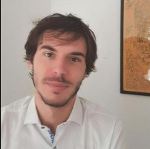
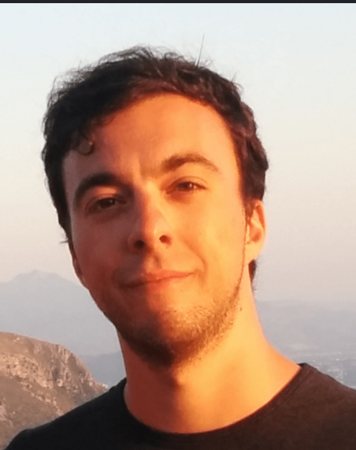
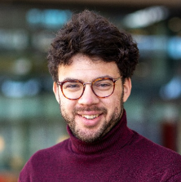
Thank you!

Slide 20
Zollman, K. J. (2018). The credit economy and the economic rationality of science. The Journal of Philosophy, 115(1), 5- 33.
Šešelja, D. (2023). Agent-based modeling in the philosophy of science.
Axelrod, R., & Hamilton, W. D. (1981). The evolution of cooperation. science, 211(4489), 1390-1396.
Chang (2014). Epistemic activities and systems of practice: Units of analysis in philosophy of science after the practice turn. In L. Soler, S. Zwart, M. Lynch, and V. Israel-Jost (Eds.), Science after the Practice Turn in the Philosophy, History, and Social Studies of Science (pp. 67–79). New York: Routledge
De Benedetto and Luchetti (2023). Specialisation by Value Divergence: The role of epistemic values in the branching of scientific disciplines. International Studies in the Philosophy of Science, 36(2), 121–141.
De Benedetto and Luchetti (2024). Theory Choice as Niche Construction: The feedback loop between scientific theories and epistemic values. Philosophy of Science, 91(3), 741–758.
De Benedetto, M., and Luchetti, M. (2025). Epistemic niche construction and non-epistemic values: the case of 19th century craniology. European Journal for Philosophy of Science, 15(2), 1-27.
Hull, D.L. 1988, Science as a process: an evolutionary account of the social and conceptual development of science, University of Chicago Press, Chicago
Longino (1990). Science as Social Knowledge: Values and Objectivity in Scientific Inquiry. Princeton (NJ): Princeton UniversityPress.
Solomon (2001). Social Empiricism. Cambridge (MA): MIT Press.
Wu, Jingyi (2023). Better than Best: Epistemic Landscapes and Diversity of Practice in Science. Philosophy of Science.
Michelini, Matteo & Javier, Osorio (2025). Can Scientific Communities Benefit from a Diversity of Standards? Philosophy of Science:1-24.
Michelini, Matteo and Šešelja, Dunja (2026) Epistemology of Agent-Based Modeling. [Preprint] URL: https://philsci-archive.pitt.edu/id/eprint/30232 (accessed 2026-06-26).

