Slide 1
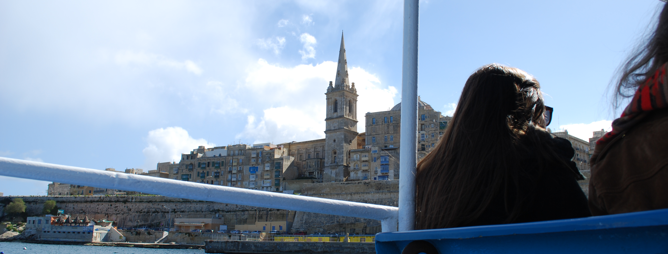
Malta – Migration policy from the perspectives of different actors
04.07.2014
MAREM – Workshop | 04.07.2014 | Mona Rosenberg, Dorina Hackmann
Notes:
Hello everybody! I am Mona Rosenberg and this is Dorina Hackmann, we are the expert group for Malta. At the beginning of March, both of us and Mara Hasenjürgen went to Malta and stayed for a week in Sliema. In this week we conducted several interviews with Maltese actors in the field of migration policy. Today, we are presenting to you our research results and especially are talking about the different opinions about the Maltese migration policy and how the organizations related to this field and governmental institutions see themselves and each other.

Slide 2
Table of contents
Introduction
Research Question
State of the art
Data
Research Results
Conclusion
References
MAREM – Workshop | 04.07.2014 | Mona Rosenberg, Dorina Hackmann
Notes:
In the beginning, we are giving you a short introduction to the country itself and mention some important facts about Malta, followed by our research question. Then we are presenting to you the current state of the art. Afterwards, we are presenting the organizations we have talked to, then we are presenting our research results concerning our research question. Finally, we are giving a short conclusion and then, of course, the references.

Slide 3
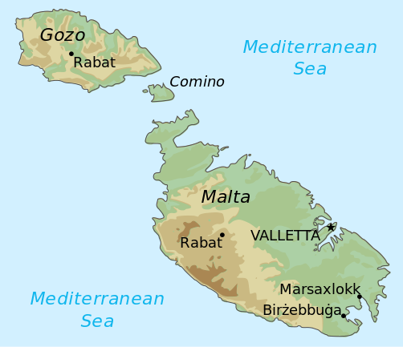
Basic information
Population: 421.364
Area: 316 km²
Unemployment rate: 6,7%
2013: 2200 applications 4,5 per 1000 inhabitants
Countries of origin: Somalia, Eritrea, Syria, Libya, Nigeria
Government (MLP) President: Marie Louise Coleiro Preca, since 2014
Prime minister: Joseph Muscat, since 2013
MAREM – Workshop | 04.07.2014 | Mona Rosenberg, Dorina Hackmann
Notes:
As giving a quick overview of the country, I am now presenting different numbers and facts about Malta. The current population of Malta, according to Eurostat, is roughly about 420.000 people. The area is 316 square kilometers, which includes three islands, as we are seeing here Malta as the biggest of them and then Gozo and Comino. Malta, compared to the other countries presented today, is very small, but nonetheless, very important to our subject. Malta has an unemployment rate of 6,7% at the moment.
In 2013, Malta had 2200 applications of people seeking asylum, this is in relative numbers 4,5 per 1000 inhabitants.
In the EU, Malta has the highest number of asylum-seekers compared to its national population. The main countries of origin are Somalia, Eritrea, Syria, Libya and Nigeria and mainly the refugees start their journey across the Mediterranean from the Libyan coast. The current government of Malta is ruled by the Malta Labour Party: As their president, elected in April 2014, Marie louise Coleiro Preca and the prime minister Joseph Muscat, in office since 2013.

Slide 4
Basic information
Centralized asylum procedure: Detention Centers, Open Centers
Protection: Refugee status, Subsidiary protection, Temporary Humanitarian Protection (→ THP new)
History: → Independence in 1964 → Geneva Convention in 1971 → Refugee Act in 2000, → Office of the Refugee Commissioner opened in 2001 → Malta joined EU in 2004
→ Part of Schengen Area
MAREM – Workshop | 04.07.2014 | Mona Rosenberg, Dorina Hackmann
Notes:
Malta has a centralized asylum procedure, the office of the refugee commissioner is in the capital, Valletta. An important fact of Malta is that all the people arriving are firstly go into detention centers until the application is decided, apart from special cases as pregnancy, unaccompanied minors etc. After a maxium stay of 18 months, they can apply to live in open centers. There are different types of protection asylum seekers can recieve: Refugee status, Subsidiary protection, Temporary Humanitarian Protection There is also the Temporary Humanitarian Protection new, which is for asylum seeker whose asylum claim was rejected twice but who had been in Malta before 2007, this is a special case which can not really be compared to the other protection statuses. As an interesting topic the THP new is, maybe we can bring it up to discussion with our expert afterwards as we have a limited time to present.
To give a short overview of the history of Malta: It gained its independence from the British government in 1964, signed the Geneva convention in 1971. The Maltese Government established the Refugee Act in 2000 and opened the Office of the Refugee Commissioner in 2001. In 2004, Malta joined the EU and is part of the Schengen Area. So as we can see the government of Malta is concerned with this topic since not such a long time.

Slide 5
Research question
In how far does the way Maltese local actors deal with the problem of refugees confirm the validity of the multilevel institutionalist collective actors approach?
Multilevel institutionalist collective actors approach: Different collective actors’ aims and strategies at European, national and local level; many different “talks and actions”, in many fields and at all levels tensions between “talk and action”, but in the long run decoupling of “talk” and “action” impossible
MAREM – Workshop | 04.07.2014 | Mona Rosenberg, Dorina Hackmann
Notes:
Now we will come to our research question: In how far does the way Maltese local actors deal with the problem of refugees confirm the validity of the multilevel institutionalist collective actors approach? As we have heard before, the multilevel institutionalist approach says that there are different actors which have different aims and strategies. On our trip to Malta, we have interviewed researchers, governmental institutions and Non-governmental organizations. In how far their interests and actions differ and in how far this may lead to further problems has been a very interesting aspect of our trip. This is what we are going to explain on the next slides by referring to the interviews that we have conducted and in the end, we will answer our research question.

Slide 6
State of the art
Debono, Daniela, 2013. ‘Less than human’: the detention of irregular immigrants in Malta.
Bernadie-Tahir, Nathalie / Schmoll, Camille, 2014. Opening up the island: a 'counter-islandness' approach to migration in Malta.
We did not find literature/ studies which answer our research question
MAREM – Workshop | 04.07.2014 | Mona Rosenberg, Dorina Hackmann
Notes:
Now we will come to the state of the art, meaning which literature could be used in respect to our research question. We tried to find literature but unfortunately we could not find that much specifically on our topic. It is also worth noting that quite a lot of research in Malta is produced by NGOs and IGOs and not only academics. However, we have picked two articles that, even if not specifically fitting to our research question, in their wider sense provide information we can use for answering our question.
The first one is„Less than human“ by Daniela DeBono. It is an article which deals with the treatment of irregular migrants in Malta. From a human rights perspective, the detention system is quite problematic. The article illustrates the fundamental disconsensus between the government and the NGOs on that matter. The article is an approach from NGOs of that area and therefore, even if rather indirectly, can provide insight to the relation and local structure of different actors performing in Malta.
The second article is „Opening up the island: a ‘counter- islandness‘ approach to migration in Malta“. It deals with discourse and preconceptions on irregular migration and islandness. The authors critically argue with the concept of an island as being „isolated, immobile and homogeneous space“ and examine the island as an concept of „barrier, hub and place of settlement.“ This fits to both conceptions of non-governmental and governmental organization. As the governmental organizations mostly think that being an island brings rather disadvantages, as the NGOs argue that it can help to establish longterm structures, concerning the migration policy.
All in all, we didn‘t really find literature which fitted completely to our research question. We think however that our interviews provide enough material to successfully answer our research question

Slide 7
Data analysis
Characteristics Actor types | Organization | Norms/values (religious, political, human rights etc.) | Dominant issue (only on A&R or multiple) | Field of legitimation (regional, local, national, EU, global)
Official-executive actors | -Former Refugee Commissioner -Refugee Commissioner -Assistant Refugee Commissioner -Primary Health Care | Protection of the Maltese state | A&R A&R A&R multiple | national national national national (EU)
A&R-related NGOs | -Aditus -Jesuit Refugee Service -People for Change -KOPIN -Emigrant’s Commission | Human rights Religious, Human Rights Human Rights Human rights Religious All political | A&R A&R A&R A&R (Multiple) | national national national national national (EU)
Researcher | University of Malta (Derek Lutterbeck) | Scientific | A&R | National, EU, global
MAREM – Workshop | 04.07.2014 | Mona Rosenberg, Dorina Hackmann
Notes:
Here we have a table of our interview partners in Malta.
We interviewed four representatives of state agencies, five NGO experts, and one researcher.
We had the great opportunity to talk to the former Refugee Commissioner as well as to the current Refugee Commissioner and his assistant. We talked to a representative of one Health Organisation. They are interested in the protection of the Maltese State and they mainly deal with the asylum procedure and refugees and asylum seeker. They field of legitimation is firstly on a national level, but as well also EU orientated.
We talked to five different NGO‘s: The values of most of them lie in the field of Human Rights and two of them are religiously orientated. All of these are A&R related and they work on a national level. Some are also working on a EU level. Interesting to know is that the Emigrants Commission, founded in the 1950‘s, is a NGO led by the church which firstly was concerned with migrants arriving in Malta and until the Office of the Refugee Commissioner was founded, was concerned with asylum claims. Currently, they are building a museum of the migration history of Malta.
It was only possible for us to meet one researcher who is a professor at the University of Malta. But some NGO‘s as Aditus, JRS and PfC also write research reports.
All in all, the diversity of our interview partners made our trip to Malta very interesting and provided insight from different perspectives to the great complexity of the topic of migration policies.

Slide 8
Research Results
How do different collective actors see themselves and other relevant actors?
How do these different actors describe the current migration policy of Malta and where do they see its basic problems?
MAREM – Workshop | 04.07.2014 | Mona Rosenberg, Dorina Hackmann
Notes:
Now we will come to our research results. Questions that we have focused on in order to answer our research question are the following: how do different collective actors see themselves and other relevant actors? How do these different actors describe the current migration policy and where do they see its basic problems?

Slide 9
Different actors → different actions
Different emphasis on interests and actions
MAREM – Workshop | 04.07.2014 | Mona Rosenberg, Dorina Hackmann
Notes:
We are going to relate this to the Multilevel institutionalist collective actors approach, as we talked about it before. Different actors follow different motives which lead to different actions. As we can see different actors have other emphasis on interests and this is visible in their actions.

Slide 10
Role of researchers
Only talked to one researcher (is not currently researching in the area)
Interested in doing research
Delivering important results for NGO‘s and governmental organizations
MAREM – Workshop | 04.07.2014 | Mona Rosenberg, Dorina Hackmann
Notes:
One type of collective actors in the field of migration policies are researchers. On our trip, we only had the possibility to talk to one researcher, who unfortunately is not currently researching in the area. Nonetheless, it was a very informative talk because his research provides insight to the complex matter of the travel organization and travel routes of refugees. These results also are of great importance to the work of NGO‘s and governmental institutions. Besides, we have also talked to NGOs who conduct their own research or are involved in bigger research projects.

Slide 11
Governmental actors about the basic problem
“Maltese people were worried. Malta was not prepared for such a phenomenon in such a short time.“
“The main problem is: You’ll never know how many are going to come.”
“There are 300 people arriving. 299 of them are really good people, but there is one criminal among them. You don‘t know.“
MAREM – Workshop | 04.07.2014 | Mona Rosenberg, Dorina Hackmann
Notes:
Now we will come to what governmental actors stated to be the basic problems. As Mona has already mentioned when talking about the historical background, in the year 2002, many refugees started to arrive at the Maltese coast. The first quotation (M003)) describes that was that Malta was not prepared at all at that point of time and they were overwhelmed by the numbers of people arriving. Besides, Maltese people were not necessarily „happy“ about the phenomenon and were afraid whether it would even establish in the future. (Quotation 2 (M005)) –The second quotation indicates that from governmental perspective, they main problem is the unpredictability of the matter, which makes it hard to plan for the future because there are different factors affecting the migration flows.
(Quotation 3 MONA READS (M003)) This statement was given in order to justify the detention policy of the government and to illustrate how it can become a security risk not to clarify people‘s identity right at arrival. So the basic problem for the government, in short, is that one will never be able to predict the future of arrivals and furthermore that simply no one knows who the arriving people are and where they respectively come from.

Slide 12
NGOs on Their Role & The Basic Problem
“trying to be the bridge between them [the refugees] and the state agencies“
“NGOs try to help and bridge the gap to official insitutions.”
“We are working in a system we are against. […] We are constantly fighting the system.“
MAREM – Workshop | 04.07.2014 | Mona Rosenberg, Dorina Hackmann
Notes:
Having now heard about the governmental point of view it is also interesting to see how NGO would define their role in the system and what from their perspective is a basic problem for their work.
The first and second quote ((M004), (M008)) show that NGOs see themselves as institutions which help refugees to cope with the overwhelming problems they are confronted with at arrival and which might make them feel helpless. For example if they are having certain problems with their asylum claims or even if they need certain essentials for living, like clothes, food. So most NGOs describe their task in bridging the gap to official institutions, while at the same time clearly stating that there is a gap. However, the NGOs resources are limited financially and in terms of staff. That is why sometimes NGOs also refer refugees to state agencies to get support, depending on the individual problem of the respective refugee.
(Quotation 3 MONA READS (M004)) This quotation shows that NGOs distance themselves from governmental institutions and that they see a main problem in the Maltese system. The basic problems for them lie in the way the government deals with the refugees. A good example is the current detention policy. NGOs consider the living conditions in detention centres as inhumane and not fulfilling human rights standards, still, the NGOs go there regularly in order to offer support and specific services to the people living in detention. That is meant by „working in a system we are against“, they are against the system, but they form also an important part of it.

Slide 13
NGO‘s and Governmental institutions on
Malta‘s migration policy
A migration policy based on crisis management?
Governmental organization: “We are always in a crisis management situation.“
NGO: “They treating them as if they were gone by tomorrow. We need strong, sustainable long term structures.”
MAREM – Workshop | 04.07.2014 | Mona Rosenberg, Dorina Hackmann
Notes:
As we have already discussed, Malta‘s immigration policy is quite recent and had to be established in a short period of time. The arrival of many immigrant at the same time overwhelmed the Maltese people all of a sudden. Still, more than ten years have passed since the Refugee act and even governmental institutions still say “We are always in a crisis management situation.“( see M005)
While governmental institutions take this as a fact because it cannot be predicted how many people will come every year, NGOs blame the government for not creating strong, sustainable long term structures and demand for a migration policy in the long run.

Slide 14
NGO‘s criticism
“Every year, summer comes, it‘s a crisis, lots of people, we don‘t know what to do. Then winter comes, things get a bit quiet and then we start all over again. We have yearly amnesia.“
“Out of sight, out of mind attitude“
MAREM – Workshop | 04.07.2014 | Mona Rosenberg, Dorina Hackmann
Notes:
Here we have a quotation which very well summarises the position of NGOs concerning the government‘s crisis management based policy: Read Mona (M004)
Our interview partnere here almost cynically refers to immovability of the government‘s policy by calling it a „yearly amnesia“. Indicating that Malta for more than ten years is faced with the same problem of immigrant arrivals every year, from our interviewee‘s perspective the government still has not succeeded to go a step forward, so to improve the structure and efficiency. That is why it is a crisis management policy, it focuses on the crisis every summer but neglects to start creating long term structures in winter, in the time period between one crisis and the next.
Besides the NGOs blame the government for having an out-of-sight-out-of-mind attitude which considers and treats the arriving people as if they were gone by tomorrow, denying that most people that arrive in Malta will at least stay there for some years. (see M008)

Slide 15
Governments justification & NGO‘s reaction
Malta‘s size as a justification?
Governmental organization: “ When you think of the size of Malta, it is the smallest state in the EU. It is the first stop, it is the place where the needs are highest.”
NGO: “The Maltese government keeps asking for more support from the other EU countries. We don’t agree with the Maltese government in the way of presenting the situation. They choose not to handle the situation in a good way.”
MAREM – Workshop | 04.07.2014 | Mona Rosenberg, Dorina Hackmann
Notes:
Now we will come to the government‘s way of justifying the problems of Maltese migration policy.
Read quote 1 Dorina (M005).
The governmental organizations tend to focus their arguments on Malta‘s size and see this as a reason to have a special demand on „burden-sharing“ (responsibility-sharing) on an European level.
The NGOs severely criticise this passive attitude of the government.
Read quote 2 Dorina (M001).
The choice of words of our interviewee here indicates that he blames the government for intentionally choosing to refer the problem to an international level. This is an argument that will be repeated by other NGOs on the next slides.

Slide 16
Demand of NGO‘s: “Stop crying, start acting.“
“We have a big plot to play. The Maltese government has to get attached together and stop crying, and act. […] Before we expect other people to do anything, we have to do our part as well.“
MAREM – Workshop | 04.07.2014 | Mona Rosenberg, Dorina Hackmann
Notes:
And here another quotation that briefly summarises what all NGOs we talked to demand from the government. Read quote Dorina (M004).
.

Slide 17
Is there a political will?
Former Refugee Commissioner: “I think there is a will. But there are not always the resources. You have to build these resources up.“
NGO: “I don‘t think there is the political will. Migrants don‘t have a vote, Maltese people do. So we please the Maltese people who want to see the migrants locked up in detention.“
MAREM – Workshop | 04.07.2014 | Mona Rosenberg, Dorina Hackmann
Notes:
So now we come to our last research results. Interestingly, we never intended to ask specifically the question „Is there a political will?“, so it was not part of our questionnaire. However, we have two quotations, one from a governmental institution, in this case even the former refugee commissioner and a Non-governmental organization.
Dorina: Read quote 1 (M003). Read quote 2 (M004).
Here you see the fundamental difference between the governmental and the NGO perspective. Governmental organizations see the problem in the lack of resources and the unpredictability of the matter. NGOs do not see a lack of resources but accuse the government for not having the political will to actively change and improve the current system.

Slide 18
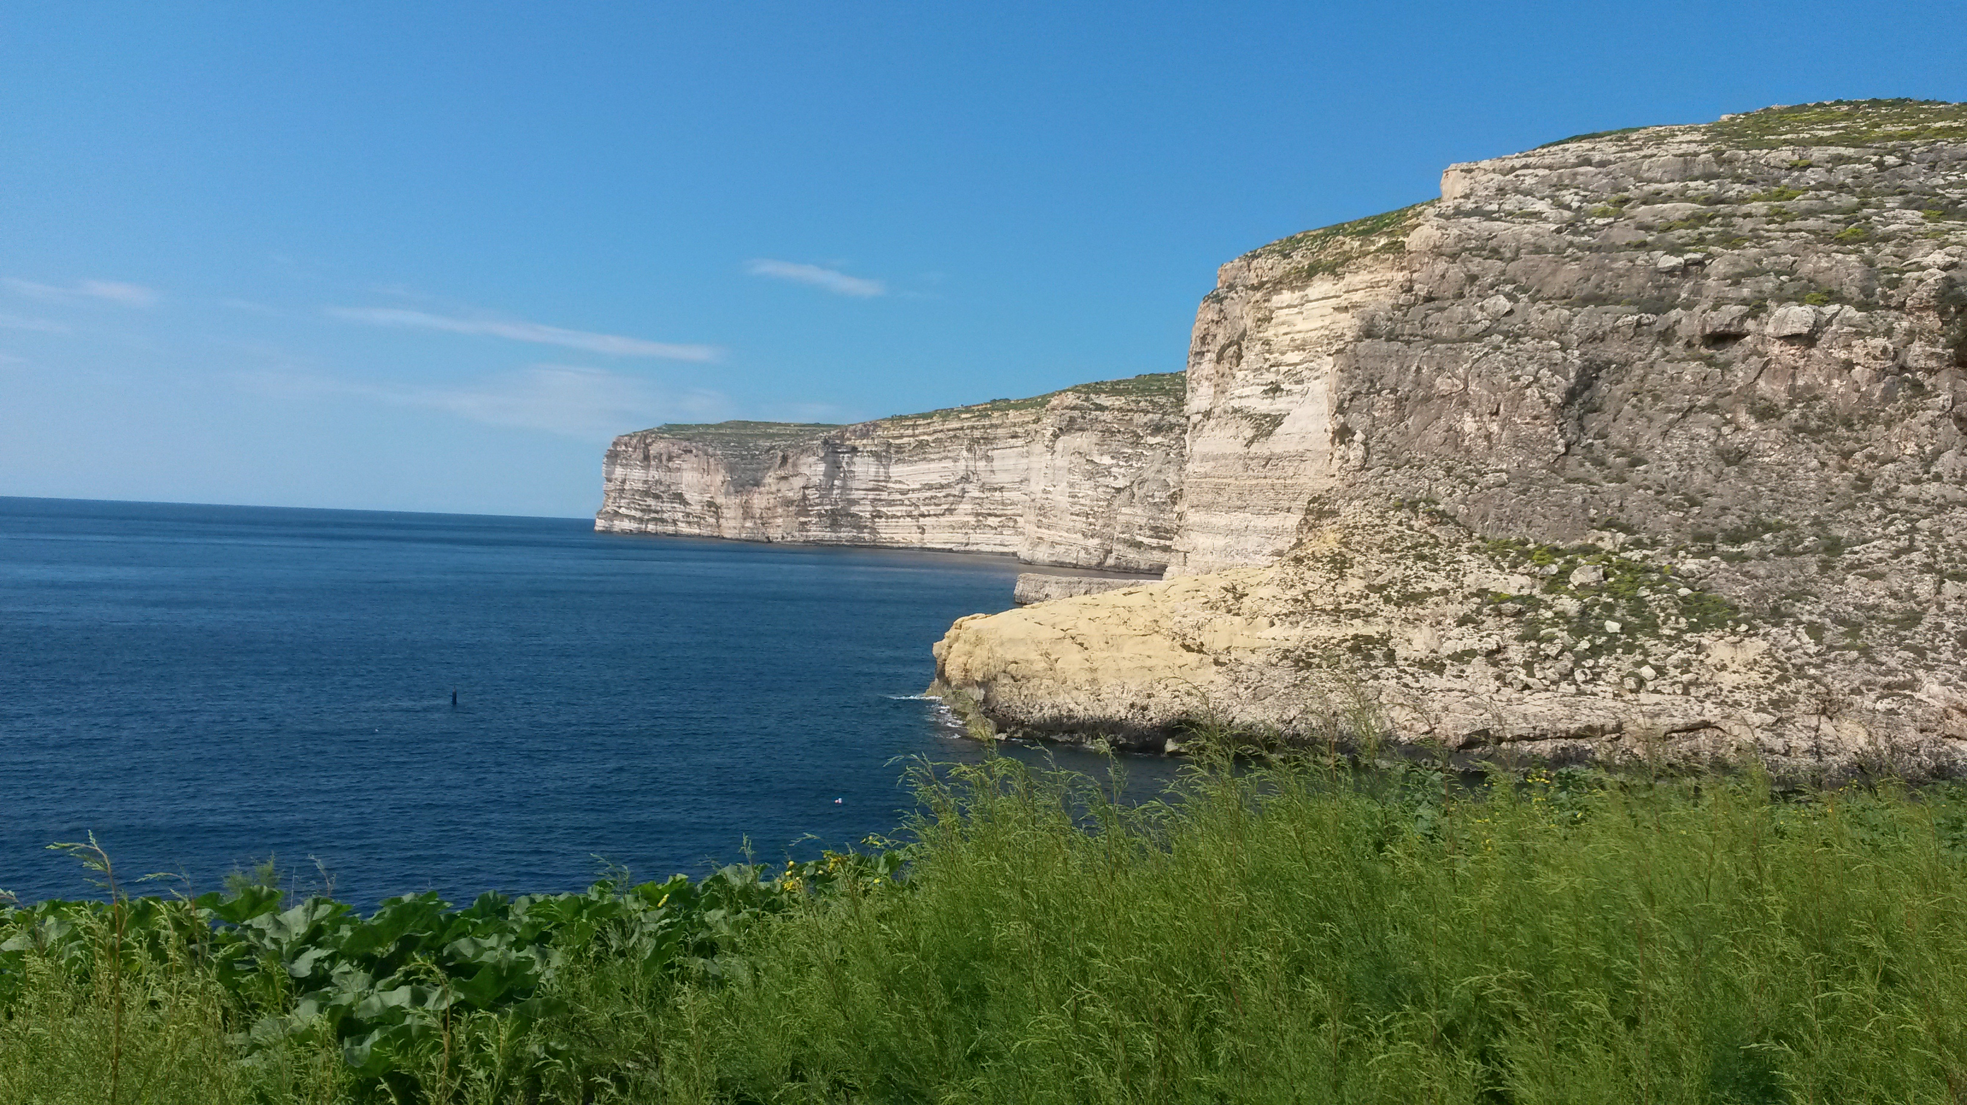
Conclusion
MAREM – Workshop | 04.07.2014 | Mona Rosenberg, Dorina Hackmann
Notes:
Now we will come to our conclusion.

Slide 19
Conclusion
Since 2002: many immigrant boat arrivals, Malta not being prepared for this phenomenon
Different local actors: →Researcher are important concerning delivering important information →State agencies are concerned with asylum procedures and in how far it affects Maltese politics → Local NGOs see their role in bridging the gap between the refugees and the official institutions
Most NGOs are severely criticising the migration policy performed by the Maltese government
MAREM – Workshop | 04.07.2014 | Mona Rosenberg, Dorina Hackmann
Notes:
Since 2002, Malta is faced with a huge amount of immigrant arrivals. Not being prepared for this phenomenon, Malta had to start creating a structure to deal with the refugees arriving. But the problems are maintained in Maltese society until today.
Different local actors deal with the problem of immigrant arrivals. While the state agencies are concerned with asylum procedures, researchers are important for delivering new research results in the field of study.
The local NGOs see their role in bridging the gap between the refugees and the official institutions. Though most NGOs are severely criticising the migration policy performed by the Maltese government, they find themselves working in a system they are against, which makes work and cooperation difficult.
Detention could be considered as an example for this problem, since it is the most controversially discussed topic in Malta. While NGO‘s consider detention as an unnecessary, degrading and inhumane procedure, the government argues that detention is necessary to exclude security risks by clarifying the identity of the arriving people.

Slide 20
Conclusion
Immigration policy from 2005 is still used today, although it is very outdated → Lacking of an integration policy document confirms this unwillingness to change the system
Government demands help from the European level, often use Malta‘s size as a justification to get support → NGO‘s disagree
Government: Rationalist-realist approach?
Multilevel institutionalist collective actors approach: Problem of different actors and different interests/actions
MAREM – Workshop | 04.07.2014 | Mona Rosenberg, Dorina Hackmann
Notes:
Besides, NGOs as local actors criticise the Maltese migration policy as a crisis management policy. The immigration policy from 2005 is still used today, although it is very outdated. The lacking of an integration policy document seems to confirm this unwillingness to change the system. The government sticks to its principles, that is to detain the people right at arrival. NGOs criticise this as an “out of sight, out of mind attitude“, it leads to the assumption that people eventually will leave Malta, though in most cases, they will not.
The government‘s tendency to request help from the European level instead of dealing with problems that could be solved on a local level is a further point of criticism. However, NGOs do not object to Malta's requests for assistance from the European Union in general but rather object to the message being passed that Malta is unable to cope. The NGOs think Malta is, or at least would be able to cope if they had the right structures.
Besides, Malta‘s size must not justify a passive migration policy. On the contrary, from NGOs perspective, Malta‘s size can be an advantage for working out a system with strong, sustainable long-term structures. We can even see, that the NGOs accuse the government of being not interested in destiny of refugees and asylum seekers and instead “talk” as window dressing, while there is no serious “action” intended. This would fit to the Rationalist-realist approach we heard about this morning, but the rationalist-realist approach would then only apply to one of different collective actors.
All in all, the situation in Malta confirms the validity of the multi institutionalist collective actors approach: There are different actors as governmental institutions, NGOs and researchers who have different aims and strategies at national and local level; there are many different “talks and actions”, and in many fields tensions between “talk and action” which in the long run makes decoupling of talk and action impossible. So in the end, we see our research question answered with a yes.

Slide 21
References
Bernadie-Tahir, Nathalie/ Schmoll, Camille, 2014: Opening up the island: a 'counter-islandness' approach to migration in Malta. In: Island Studies Journal, Volume 9, Number 1 pp.43-56.
Coppens, Jasmine, 2013: The Essential Role of Malta in Drafting the New Regional Agreement on Migrants at Sea in the Mediterranean Basin. In: Journal of Maritime Law & Commerce, Volume 44, Number 1, pp. 89-113.
DeBono, Daniela, 2013: ‘Less than human’: the detention of irregular immigrants in Malta. In: Race & Class, Volume 55, Number 2, pp. 60-81.
Klepp, Silja, 2010: A Contested Asylum System: The European Union between Refugee Protection and Border Control in the Mediterranean Sea. In: European Journal of Migration & Law Volume 12, Number 1, pp. 1-21.
Thomson, Mark, 2006: Migrants on the Edge of Europe: Perspectives from Malta, Cyprus and Slovenia. In: Sussex Center for Migration Volume 35.
Interviews conducted in Malta (March, 2014)
UNHCR: Malta
Eurostat: Malta
People for Change Foundation; “Researching Migration and Asylum in Malta: A Guide“, 2013
MAREM – Workshop | 04.07.2014 | Mona Rosenberg, Dorina Hackmann
Notes:
UNHCR(http://www.unhcr.org.mt/statistics)
EUROSTAT:(http://epp.eurostat.ec.europa.eu/tgm/table.do?tab=table&language=de&pcode=tps00001&tableSelection=1&footnotes=yes&labeling=labels&plugin=1)
PFC: http://www.pfcmalta.org/uploads/1/2/1/7/12174934/researching_migration_and_asylum_in_malta_-_a_guide.pdf

Slide 22
Thank you for your attention!
Mona Rosenberg & Dorina Hackmann
MAREM – Workshop | 04.07.2014 | Mona Rosenberg, Dorina Hackmann
Notes:
Thank you for your attention!

